Slide 1

Around the World in
??? Days
Sakibul Alam, Alex Gardner, Evan Toler, Wendy Knight

Slide 2
Agenda
General TSP
The Algorithm
Scheduling A Great Crawl
Rice U, City of Houston
Computational Results
Concluding Remarks
Questions
Notes:
Wendy

Slide 3
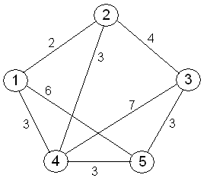
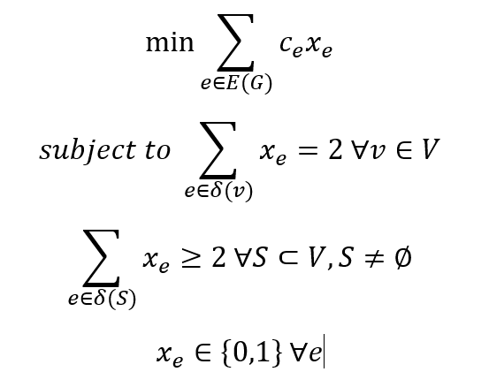
General Traveling Salesman Problem
Undirected graph, G = (V, E)
Goal: Minimize the cost, distance, time, etc.
Constraints:
Enter and exit each city once
No subtours
Notes:
Wendy

Slide 4
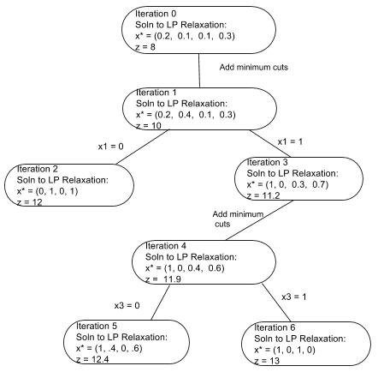
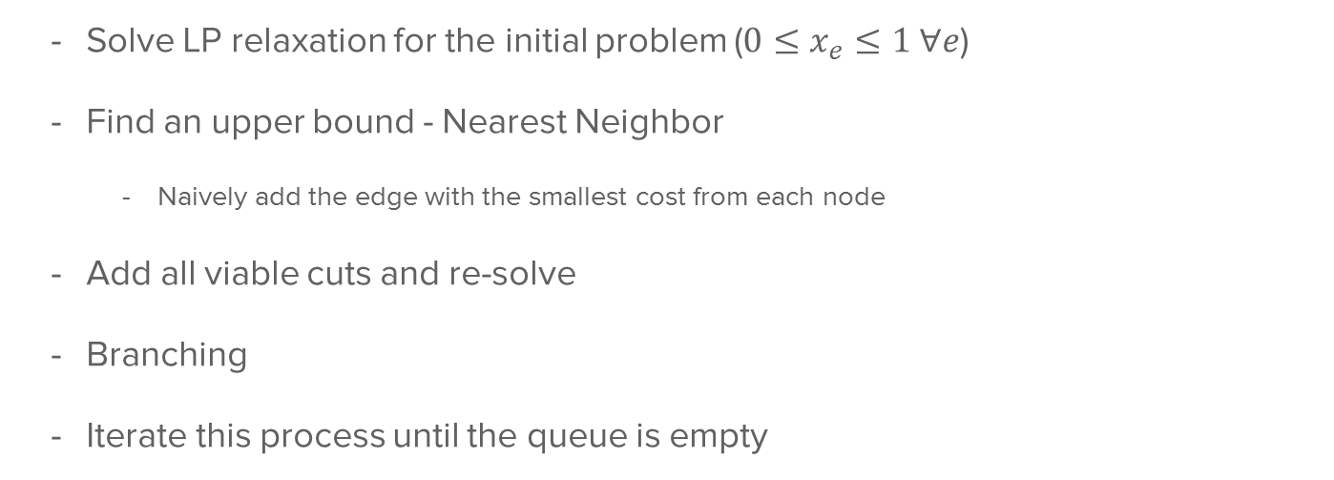
Our Algorithm
Solve LP relaxation for the initial problem ($0≤x_{e}≤1 ∀e$)
Find an upper bound - Nearest Neighbor
Naively add the edge with the smallest cost from each node
Add all viable cuts and re-solve
Branching
Iterate this process until the queue is empty
Notes:
Alex

Slide 5
Branching Conditions
Non-Integer Solution
If solution is worse than our current best, go to the next item in the queue
Otherwise, branch on fractional variable and re-solve
Integer Solution
If solution is worse than our current best, go to the next item in the queue
Otherwise, check for subtours
If subtours, re-add the model to the queue
If not, check to see if it’s better than our current best
Problems with this
Memory Taxing - many models defined at once
Notes:
Alex

Slide 6
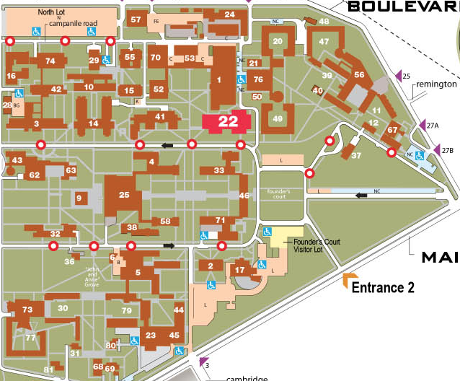
Applications - Scheduling the Shortest Crawl
Optimal Walking Time: z = 34 Minutes
Assumptions
No Traffic
Everyone walks at the same speed
Order:
Baker
McMurtry
Duncan
Martel
Jones
Brown
Lovett
Will Rice
Hanszen
Wiess
Sid Richardson
Then back to Baker
Notes:
Sakib

Slide 7
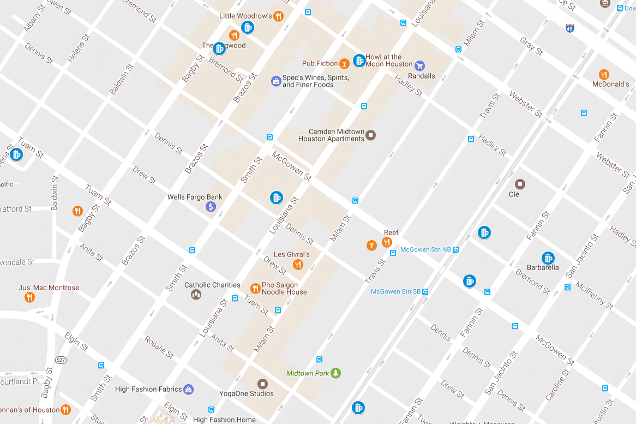
Applications - Scheduling the Shortest Crawl
Optimal Distance: z = 2.66 miles
Assumptions
No Traffic
You are 21+
You start your crawl early enough to visit each bar prior to their closing time
Order:
Nouveau Antique Art Bar
Bar Munich
F Bar
Midtown Drinkery
Shot bar
Howl at the Moon
Capitol bar
Barbarella
Mongoose versus Cobra
Notes:
Sakib

Slide 8
Computational Results
Test Case | Att48 | Berlin52 | Gr21 | Hk48 | St70 | Ulysses22
Number of Cities | 48 | 52 | 21 | 48 | 70 | 22
Number of Edges | 1128 | 1326 | 210 | 1128 | 2415 | 231
Optimal Distance | 10628 | 7542 | 2707 | 11461 | 675 | 7013
Run Time (s) | 16.86714 | 1.798841 | 0.020761 | 11.11429 | 1598.799 | 0.148680
NN Run Time (s) | 16.68480 | 1.763470 | 0.020891 | 10.98244 | 1589.454 | 0.142128
Notes:
Evan

Slide 9
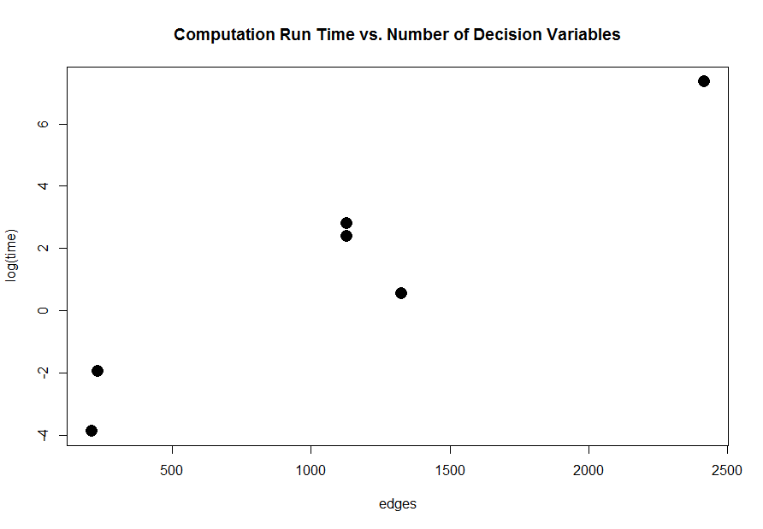
Concluding Remarks
Future Work: Gomory-Hu tree?
Our PR76 is still running… so we will get back to you on that!
Travel around the world in ??? days
Iteratively solve to find the answer!
Improvements
Reduce memory allocation in branching
Improve upper bound
Questions?
Notes:
Evan

